Slide 1
Social Engineering
by Chris Dabre

Slide 2
What is social engineering?
Social engineering is a manipulation technique that exploits human error to gain private information, access, or valuables.
In cybercrime, it is also termed as “human hacking” and it tends to lure unsuspecting users into exposing data, spreading malware infections, or giving access to restricted systems.
Social engineering is very effective and dangerous because “THE WEAKEST LINK IN SOCIAL SECURITY CHAIN IS HUMAN ELEMENT”.

Slide 3
How does the social engineering attack works?
Attacks can happen online, in-person, and via other interactions.
Scams based on social engineering are built around how people think and act.
These attacks are especially useful for manipulating a user’s behaviour.
Once an attacker understands what motivates a user’s actions, they can deceive and manipulate the user effectively.
Notes:
SOC 2 reports must have bifurcations of server reports and other assets.

Slide 4
How does the social engineering attack works?
The attack cycle gives these criminals a reliable process for deceiving you. Steps for the social engineering attack cycle are usually as follows:
1. Prepare by gathering background information on you or a larger group you are a part of.
2. Infiltrate by establishing a relationship or initiating an interaction, started by building trust.
3. Exploit the victim once trust and a weakness are established, they advance to attack.
4. Disengage once the user has taken the desired action.

Slide 5
Some statistics
Every 1 out of 3 social engineering attack results in data breaches
About 70% to 90% of all data breaches are due to phishing and social engineering attacks.

Slide 6
What are the goals of social engineers?
Obtaining personal information
Gaining unauthorized access
Sabotage: Disrupting or corrupting data to cause harm or inconvenience.
Theft: Obtaining valuables like information, access, or money.

Slide 7
The 5 common attack methods of social engineering
Dumpster diving
It means searching trash for useful information.
The trash may be in a public dumpster or in a restricted area requiring unauthorized entry.
Dumpster diving depends on a human weakness: the lack of security knowledge
Physical entry
attacker tries to gain physical access to an organisation's physical premises in an attempt to access sensitive information and internal systems

Slide 8
The 5 common attack methods of social engineering
3. Pretexting
Here an attacker obtains information through a series of cleverly crafted lies.
The attacker usually starts by establishing trust with their victim by impersonating co-workers, or persons who have right-to-know authority.
4. Baiting
In this attack a scammer uses a false promise to lure a victim into a trap which may steal personal and financial information or inflict the system with malware.
The trap could be in the form of a malicious attachment with an enticing name.

Slide 9
The 5 common attack methods of social engineering
5. Phishing
Phishing attacks use email or malicious websites to solicit personal information by posing as a trustworthy organization.
For example,
an attacker may send email seemingly from a reputable credit card company that requests account information, suggesting that there is a problem.
When users respond with the requested information, attackers can use it to gain access to the accounts.

Slide 10
Damage phishing can cause to an organization
Phishing bypasses technical security factors by exploiting the human component.
This attack method has the potential to render technical security controls useless.
Spear phishing attacks may allow attackers to gain a foothold into the organization’s systems all while the organization remains unaware.
These attacks deliver malware that allows attackers to control a victim’s machine.

Slide 11
Damage phishing can cause to an organization
Privileged access from compromised computers, allow attackers to bypass many technical security controls.
This may also allow attackers to pivot and escalate their access to other systems and data.
Ultimately, this can result in the complete compromise of an organization.
This could include customer and employee data theft, source code leaks, website defacing, etc

Slide 12
What are common indicators of phishing attempts?
Suspicious sender’s address.
The sender's address may imitate a legitimate business.
Cybercriminals often use an email address that closely resembles one from a reputable company by altering or omitting a few characters.
Spelling and layout.
Poor grammar and sentence structure, misspellings, and inconsistent formatting are other indicators of a possible phishing attempt.

Slide 13
What are common indicators of phishing attempts?
Generic greetings and signature.
Both generic greeting such as “Dear Valued Customer” or “Sir/Ma’am” in the signature block are strong indicators of a phishing email.
A trusted organization will normally address you by name and provide their contact information.
Suspicious attachments.
An unsolicited email requesting a user download and open an attachment is a common delivery mechanism for malware.

Slide 14
What are common indicators of phishing attempts?
Spoofed hyperlinks and websites.
If you hover your cursor over any links in the body of the email, and the links do not match the text that appears when hovering over them, the link may be spoofed.
Malicious websites may look identical to a legitimate site, but the URL may use variation in spelling or a different domain (e.g., .com vs. .net ).
Additionally, cybercriminals may use a URL shortening service to hide the true destination of the link.

Slide 15
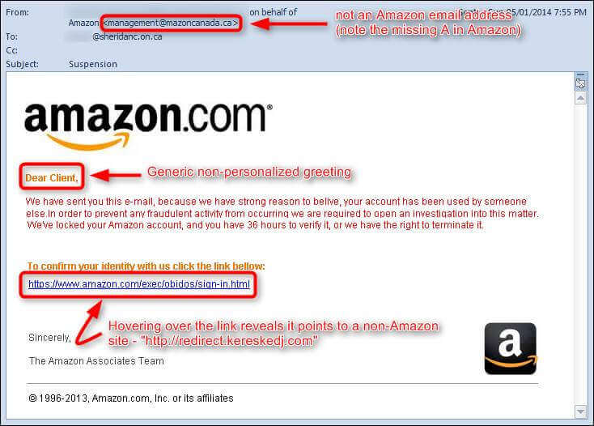
Example with some case studies

Slide 16
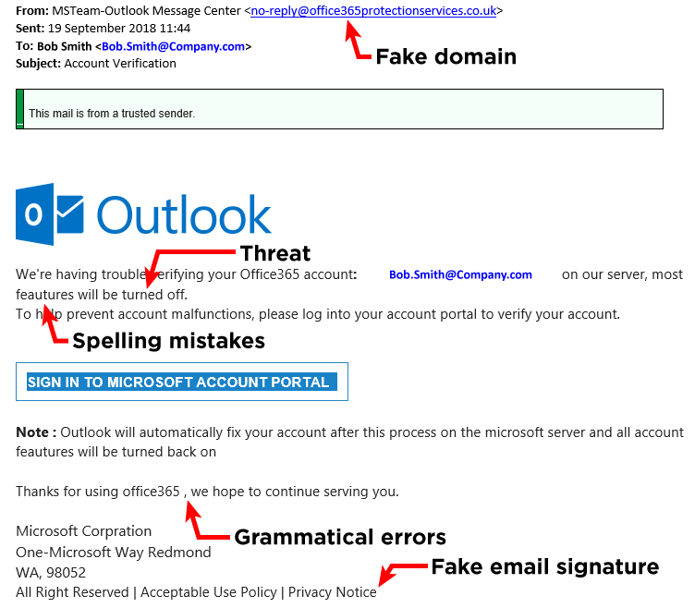
Example with some case studies

Slide 17
How can you avoid being a victim?
Be suspicious of unsolicited phone calls, visits, or email messages from individuals asking about internal information.
If an unknown individual claims to be from a legitimate organization, try to verify his or her identity directly with the company.
Do not reveal personal or financial information in email, and do not respond to email solicitations for this information.
If you are unsure whether an email request is legitimate, try to verify it by contacting the company directly.

Slide 18
Thank You.

Slide 19
Process of downloading or installing third application with approval
Application management provides a controlled installation and uninstallation process for software that requires approval.
The IT administrator uses Software Center and deploys an application to all users and configures it to require approval before they're installed.
the user browses the list of applications in Software Center but can't install the application until the request is approved.
The user has to specify the reason for the request, then admin approves or denies the request for each of the user's devices where requests were made.

Slide 20
downloading application on corporates system without permission
Websites that user visits can download and install software without their knowledge or approval.
It is called a drive-by download.
The objective is usually to install malware, which can:
Record whatever is typed and what sites are visited.
Search computers for stored passwords.
Open the computer to remote control.
Legitimate sites can also be hijacked into hosting drive-by downloads through third-party ads.

Slide 21
pirated & Crack applications
A crack is a way ( programs) that makes applications or software work perfectly without the need to buy or pay money for those applications.
A ”crack” breaks the protection of the program so one can use it completely.
Application piracy is the use of unlicensed software where the user has never paid the software vendor a licensing fee for the application.
It can be contrasted \with “license overuse” where the user has paid a software vendor a licensing fee for an application, but is using more installations than it is entitled to use

Slide 22
Reasons not to visit pirated or cracked application
Downloads of illegal software are frequently stuffed full of dangerous malware.
the websites which distribute them, are already on the wrong side of the law. So they have little incentive not to harm their users.
When you download illegal software, there's no guarantee it will actually work.
Downloading and using cracked software is illegal. If someone is caught using it, they could face a range of consequences.
if your device is compromised by malware, that malware can spread to other devices that are connected to the internet using your home network.

Slide 23
Why financial sector is targeted by Ransomware Attacker
The finance sector gather information about clients, partners, and employees. This sensitive data makes financial services organizations ideal targets for ransomware attacks.
As financial organizations are digitizing more of their operations, they are also giving cybercriminals a wider attack surface to exploit.
Ex.
AvosLocker Attack on Community Banking Service Provider Pacific City Bank
Sodinokibi (REvil) Attack on Foreign Exchange Company Travelex

Slide 24
corporate email and personal mail does & don't
Personnel mails:
Do’s
Use two-factor authentication.
Set expiration dates on your messages.
Encrypt your email.
Don'ts
Do not forward mails without thinking.
Do not ignore your service provider’s TOS.
Corporate mails:
Do’s
be careful with passwords and credentials.
Do check URLs “on-click/every click”.
Don'ts
Don’t trust emails, even if they’re from inside.
Don’t trust attachments.

Slide 25
Office Based Exploit via email
Phishing:
Vishing:
Smishing:
Whaling:
Pharming:
Spyware:
Scareware:
Adware:
Spam:
Notes:
no

